Slide 1

Internet Of Things Hands on Workshop
DAY 1

Slide 2
Like every other IoT workshop,
What is IoT?

Slide 3
In the term, Internet of Things, “Thing” refers to any object. Eg: Table, fan, computer, phones, TV, AC, etc.
What about Sensors? Anything and Everything that connects to the Internet is a part of IoT. An object may or may not have a sensor.
Need of Internet? Connect every device with each other (inter-connect), to make a mesh of Connectivity among devices as well.
In IoT, things need not be connected with cloud. They could form an IoT, even if it is running locally (LAN).

Slide 4
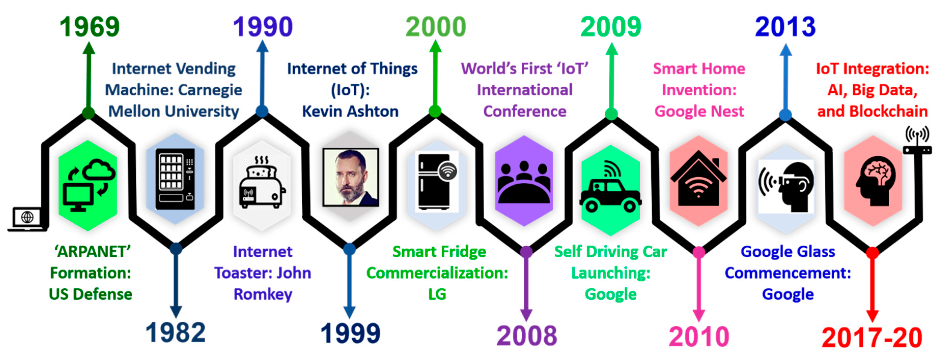

Slide 5
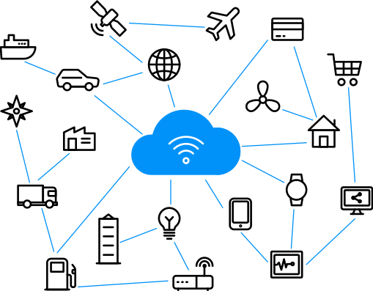

Slide 6
Introduction to IoT
IoT Concepts
Examples
Branches of IoT
Levels of IoT
Communication Protocols
Types of IoT Protocols
IoT Communication Protocols
Serial Communication
WebServer on ESP32
Create an ESP32 WebServer
Host images from ESP32 Memory (using SPIFFS)
Use ESP32 WebServer as Access Point
Store and Visualize Data
Store data in Google Sheet
Create a google chart with the data
IoT Platforms
Use Blynk-cloud with to control ESP32
Use thingspeak API to get data of ESP32
Introduction to Arduino IoT Cloud
REST API
What is REST API?
HTTP Methods
APIs with Python
Create your Own IoT Service
Using Firebase to store data in JSON
Using self-developed REST API server - Data, chart

Slide 7
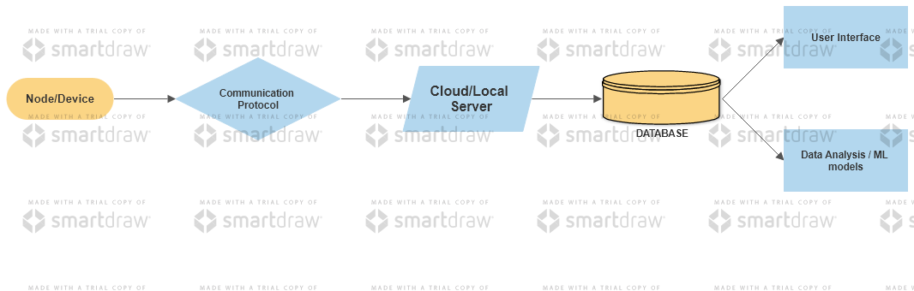

Slide 8
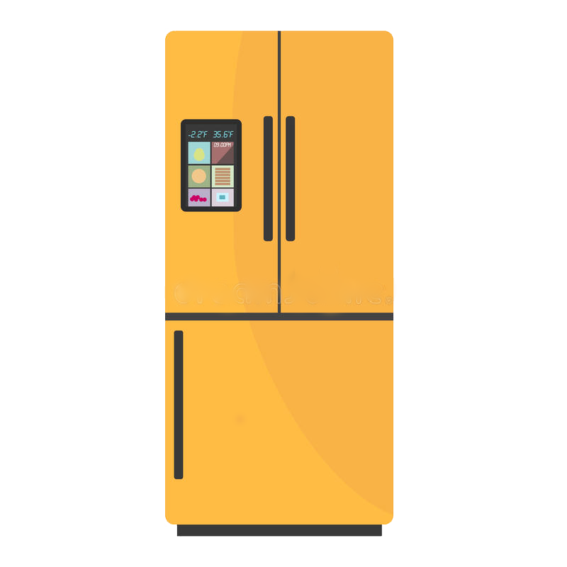
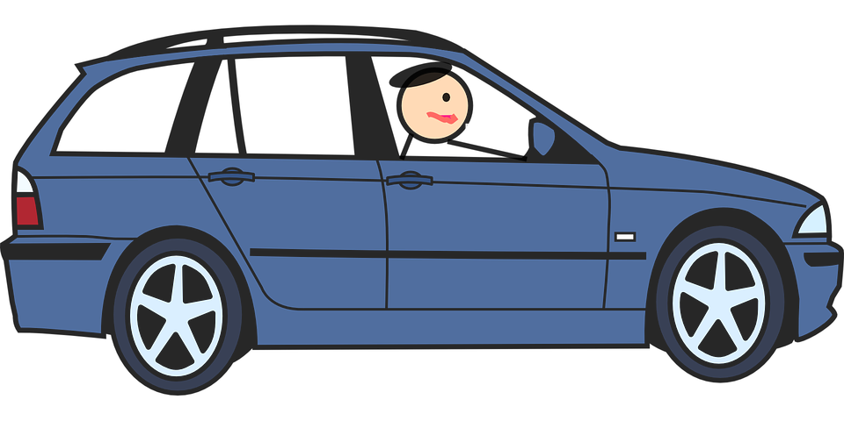

Slide 9
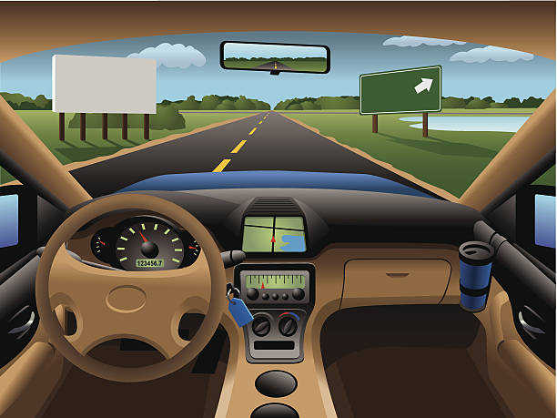

Slide 10
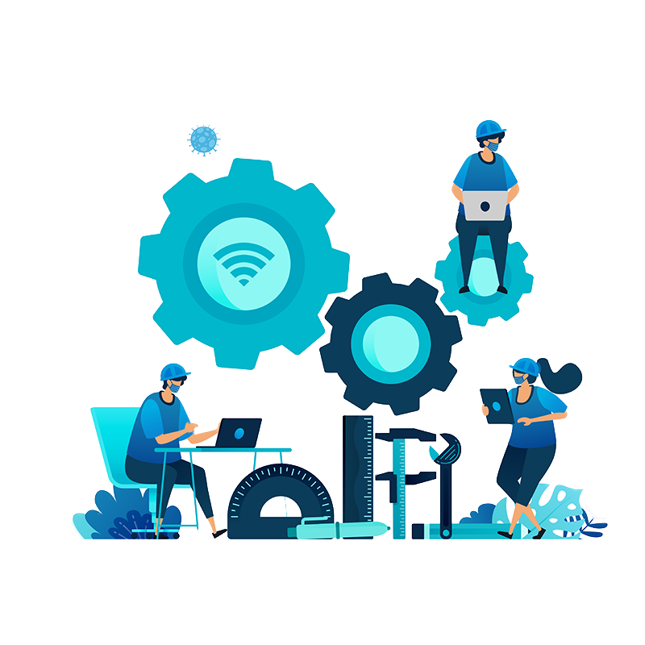
InterConnected Humans

Slide 11
Top Examples
Inventory-tracking systems (workplace, logistics, import-export, etc)
Machines in Manufacturing Factories
Tags and sensors for security
HealthCare system
Appliance Control (home-automation, smart fridge, toaster, etc)
Environmental data gathering (weather, air quality, etc)

Slide 12
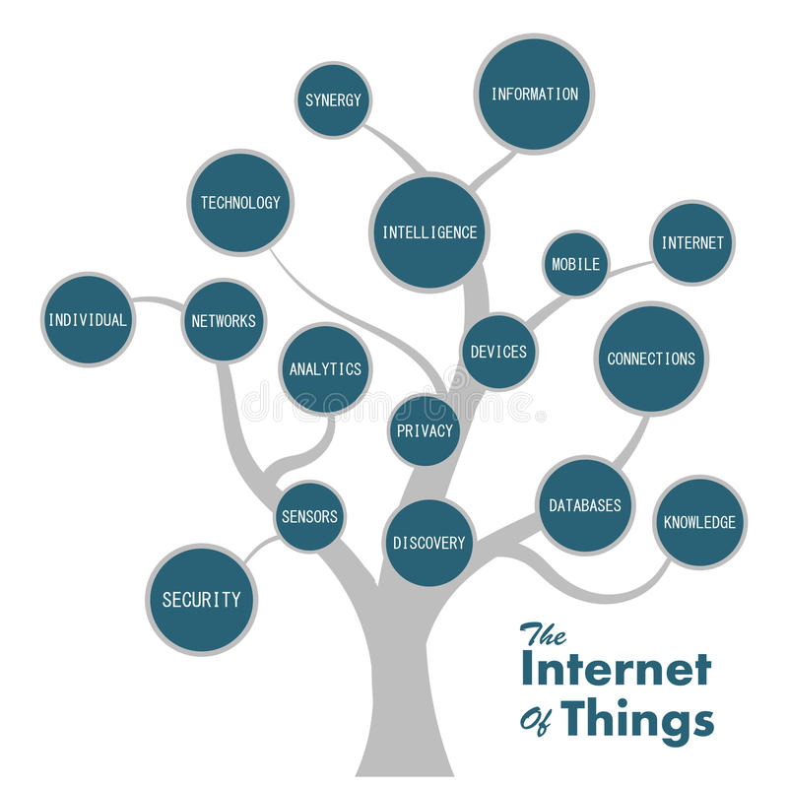

Slide 13
Branches of IoT
Data Centre
Inventory Management
Security
Mobile Device (Portable/wearable)
Asset and Fleet Management
HealthCare
Retail/Commercial Products

Slide 15
Sections in IoT network
Database: Database can be either local or in the cloud and stores the data generated by the IoT device.
Web Service: Web services serve as a link between the IoT device, application, database and analysis components. Web service can be either implemented using HTTP and REST principles (REST service) or using WebSocket protocol (WebSocket service).

Slide 16
Sections in IoT network
Analysis Component: The Analysis Component is responsible for analyzing the IoT data and generate results in a form which are easy for the user to understand.
Application: IoT applications provide an interface that the users can use to control and monitor various aspects of the IoT system. Applications also allow users to view the system status and view the processed data.

Slide 17
IoT Level 1
A level-1 IoT system has a single node/device that performs sensing and/or actuation, stores data, performs analysis and hosts the application.
Suitable for modelling low-cost and low-complexity solutions where the data involved is not big and the analysis requirements are not computationally intensive.

Slide 18
IoT Level 2
A level-2 IoT system has a single node that performs sensing and/or actuation and local analysis.
Data is stored in the cloud and application is usually cloudbased.
Suitable for solutions where the data involved is big, however, the primary analysis requirement is not computationally intensive and can be done locally itself.

Slide 19
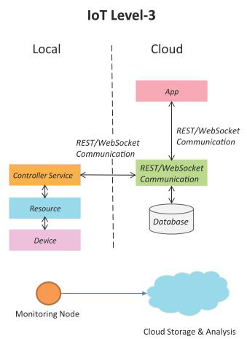
IoT Level 3
A level-3 IoT system has a single node. Data is stored and analyzed in the cloud and application is cloudbased.
Level-3 IoT systems are suitable for solutions where the data involved is big and the analysis requirements are computationally intensive.

Slide 20
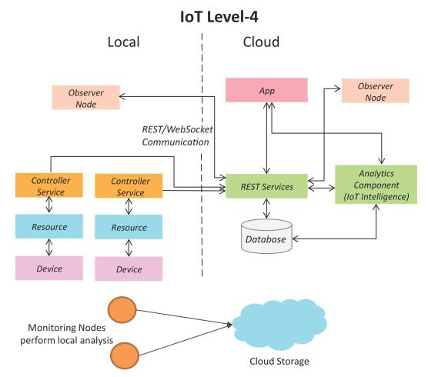
IoT Level 4
A level-4 IoT system has multiple nodes that perform local analysis. Data is stored in the cloud and application is cloud-based.
Level-4 contains local and cloudbased observer nodes which can subscribe to and receive information collected in the cloud from IoT devices.
Level-4 IoT systems are suitable for solutions where multiple nodes are required, the data involved is big and the analysis requirements are computationally intensive.

Slide 21
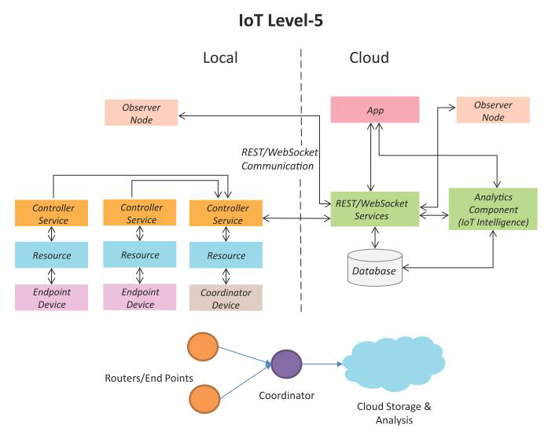
IoT Level 5
A level-5 IoT system has multiple end nodes and one coordinator node.
The end nodes that perform sensing and/or actuation.
Coordinator node collects data from the end nodes and sends to the cloud.
Data is stored and analyzed in the cloud and application is cloud-based.
Level-5 IoT systems are suitable for solutions based on wireless sensor networks, in which the data involved is big and the analysis requirements are computationally intensive.

Slide 22
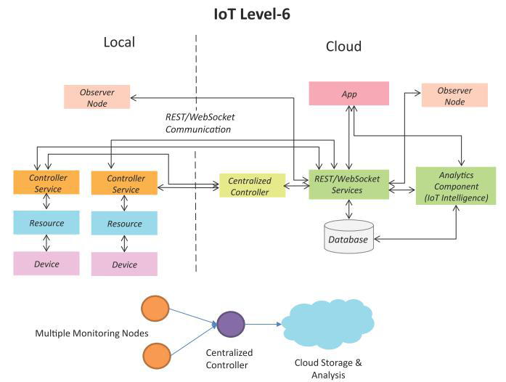
IoT Level 6
A level-6 IoT system has multiple independent end nodes that perform sensing and/or actuation and send data to the cloud.
Data is stored in the cloud and application is cloud-based.
The analytics component analyses the data and stores the results in the cloud database.
The results are visualized with the cloud-based application.
The centralized controller is aware of the status of all the end nodes and sends control commands to the nodes.

Slide 23


Type of IoT Protocol
IoT Network
IoT Data

Slide 24
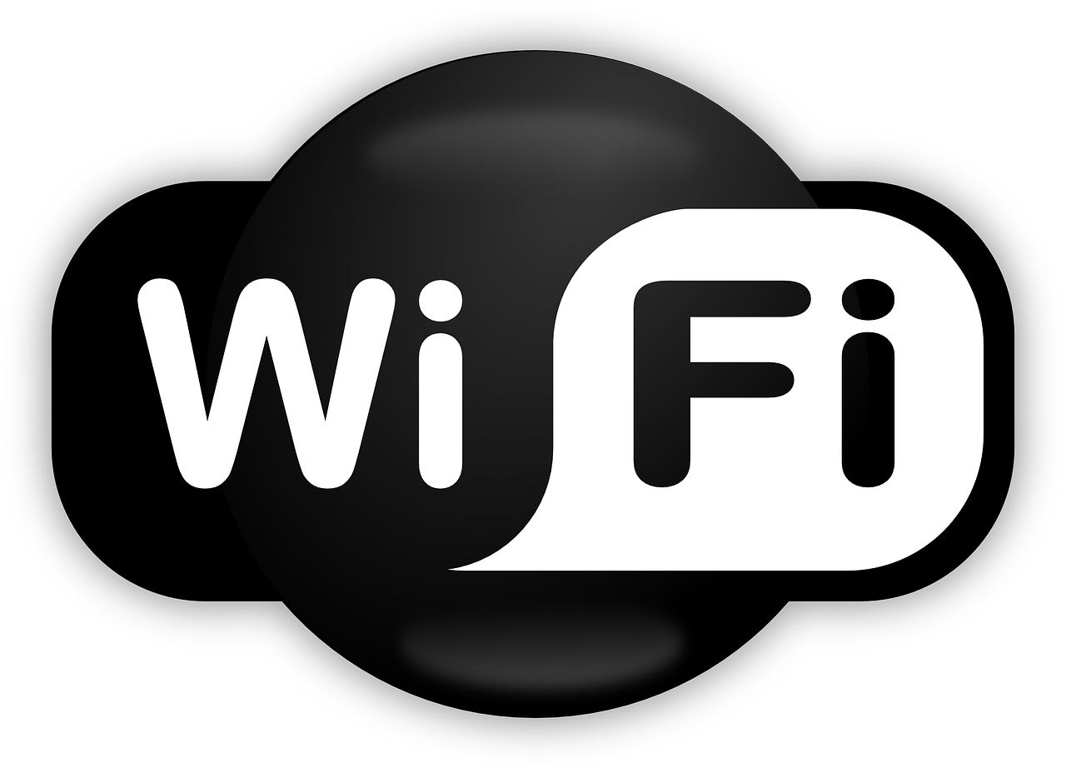
IoT Networks
1. Wifi
Standard - Based on IEEE 802.11n
Frequencies - 2.4 GHz and 5 GHz bands
Range- Approx. - 50 - 100 meters
Data Rates - 600 Mbps maximum, the most common is 150-200 Mbps.

Slide 25
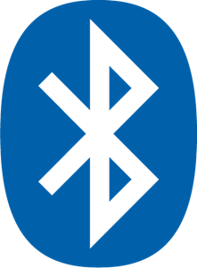
IoT Networks
2. Bluetooth
Standard - Bluetooth 4.2 core specification
Frequencies - 2.4 GHz (ISM)
Range- Approx. - 10meter - 50 meters
Data Rates - 1MBps(Smart/BLE)

Slide 26

IoT Networks
3. Zigbee
Standard - Zigbee 3.0 based on IEEE802.15.4
Frequencies - 2.4 GHz (ISM)
Range- Approx. - 10 - 100 meters
Data Rates - 250KBps

Slide 27
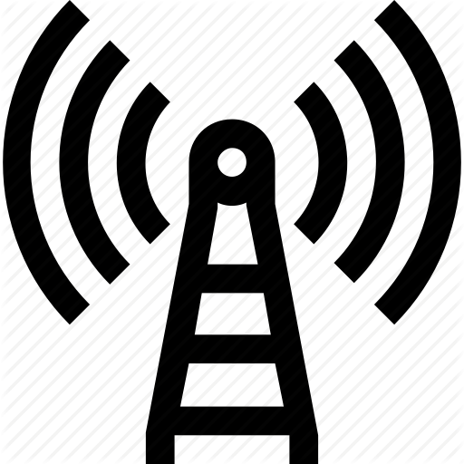
IoT Networks
4. Cellular
Standard - GSM/GPRS/EDGE(2G), UMTS/HSPA(3G), LTE(4G)
Frequencies - 900/1800/1900/2100MHz
Range- Approx. - 35km max for GSM, 200 km max for HSPA
Data Rates - 35 – 170 KBps

Slide 28
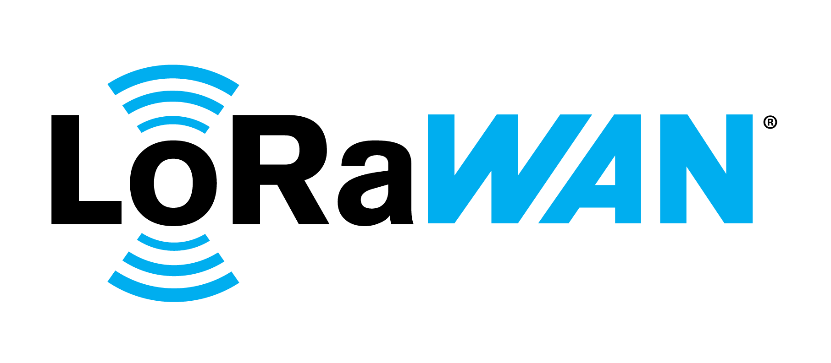
IoT Networks
5. LoRa
Standard- LoRa WAN
Frequencies- Various
Range- Approx. – 2.5km (Urban) and 15km (SubUrban)
Data Rates - 0.3 – 50 KBps

Slide 29

IoT Networks
6. SigFox
Standard - SigFox
Frequencies - 900 MHz
Range- Approx. – 3 - 10km (Urban) and 30 - 50km (SubUrban)
Data Rates - 10 – 1000 Bps

Slide 30
IoT Data Protocols
REST API- Application programming interface (API or web API) that conforms to the constraints of REST architectural style and allows for interaction with RESTful web services.
WebSocket- A computer communications protocol, providing full-duplex communication channels over a single TCP connection.
MQTT- MQTT is a lightweight, publish-subscribe network protocol that transports messages between devices. The protocol usually runs over TCP/IP, however, any network protocol that provides ordered, lossless, bi-directional connections can support MQTT.
Others - CoAP, AMQP, XMPP are some of the popular IoT data protocols.

Slide 31
Device Communication
Serial Communication - Uses one or two transmission lines to send and receive data, and that data is continuously sent and received one bit at a time.
SPI Communication - Devices are in a master-slave relationship. The master is the controlling device (usually a microcontroller), while the slave (usually a sensor, display, or memory chip) takes instruction from the master.
I2C Communication - I2C combines the best features of SPI and UARTs. You can connect multiple slaves to a single master (like SPI) and you can have multiple masters controlling single, or multiple slaves.

Slide 32
What is ESP32?

Slide 33
Espressif - 32
ESP32 is a system on a chip (SoC) that integrates the following features:
Wi-Fi (2.4 GHz band)
Bluetooth
Dual high performance Xtensa® 32-bit LX6 CPU cores
Ultra Low Power co-processor
Multiple peripherals
It provides a robust, highly integrated platform, which helps meet the continuous demands for efficient power usage, compact design, security, high performance, and reliability.

Slide 34
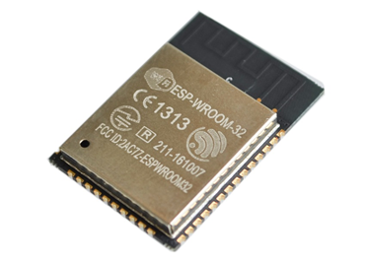
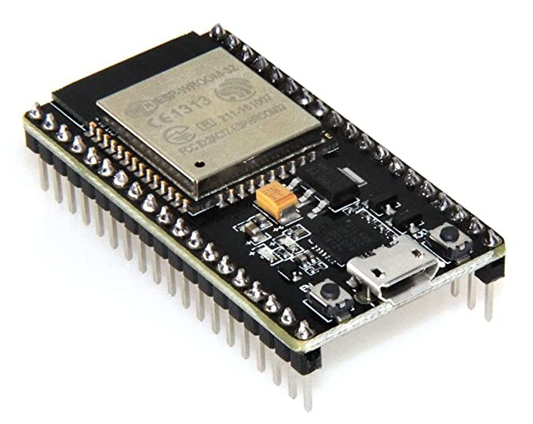
ESP32 vs ESP32 Dev Board

Slide 35
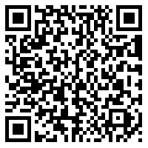
Get Started with ESP32 on Arduino IDE
shorturl.at/cySV6

Slide 36
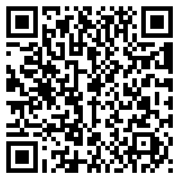
Access all Code (Web Server on ESP32)
shorturl.at/hlLV7

Slide 37


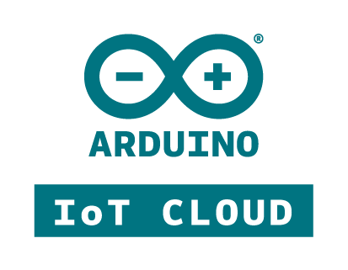
IoT Platforms
Blynk IoT
ThingSpeak API
Arduino IoT Cloud

Slide 38
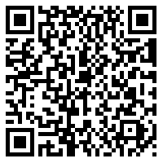
Access all Code (IoT Platforms)
shorturl.at/rvyR0

Slide 39
Arduino IoT Cloud
Arduino IoT Cloud is an application that helps makers build connected objects in a quick, easy and secure way. You can connect multiple devices to each other and allow them to exchange real-time data. You can also monitor them from anywhere using a simple user interface. Arduino has taken a step forward to keep IoT as simple and reachable as possible. Initially, IoT Cloud was available only to the Arduino Boards, but now, it even provides Web Sketches for other third-party boards like ESP8266 / 32, LoRaWAN as well.

Slide 40
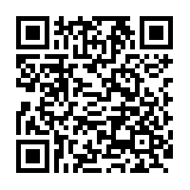
Arduino IoT Cloud
https://docs.arduino.cc/cloud/iot-cloud/tutorials/esp-32-cloud

Slide 41
TASK (1/5)
Create a Flow Diagram of an IoT Network, in a Forest
Add necessary devices and sensors required, to be used in the Wildlife of Forest.
Concern on Climate Monitor like fire, moisture, rain, etc.
Mention the IoT Level used, with an explanation on the flow. State reasons for each block.
Make sure any device/sensor MUST not link directly to any Animal or Organism.
Scores based upon Creativity and Uniqueness.
Use Pen-Paper/Photoshop/FlowChartBuilder/Anything. No restrictions on that.

Slide 42
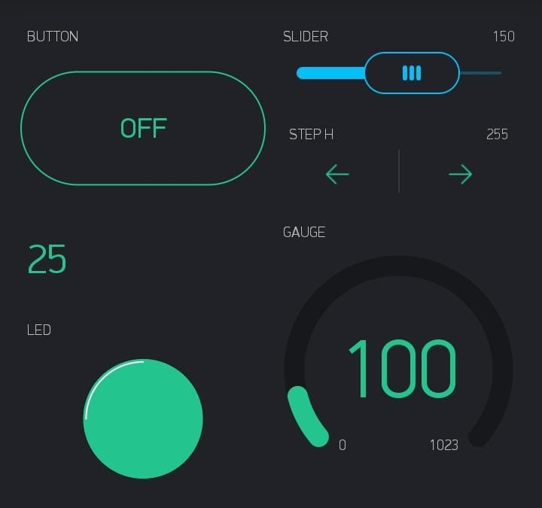
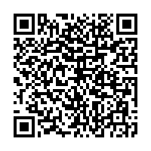
TASK (2/5)
Use the Blynk App and create a Basic Home Automation Control. Follow the Configuration :
V0 – Button
V1 – Slider (0 - 1023) – Show Value
V2 – Step H (0 - 1023) – Show Value – icon(+/-)
V3 – Value Display (0 – 255)
V4 – Gauge (0 - 1023) - ºC
V5 – LED
Copy the Auth Token of the Project and Paste it on the WebPage and click Enter.
Send a screenshot of the Blynk App with the Configuration working.
Blynk_HomeAutomation_Verifier.html

Slide 43
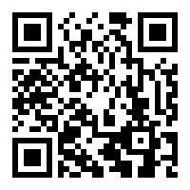
Submission Link
https://forms.gle/CG7B44EAnnkKXZZ48

Slide 44





Thank You
Reach me in the below Socials:
LinkedIn -
Hackster -
Instagram -
Github -
Mail -
linkedin.com/in/akshayansinha/
hackster.io/akshayansinha
instagram.com/akshayansinha/
github.com/hippyaki
akshayan.sinha@gmail.com

Slide 45
Meet you on 2nd November.

